Slide 1
Bio-REGNET An Ontology to Integrate Multiple Information Domains in the Patent System
Siddharth Taduri
Hang Yu
Gloria T. Lau
Kincho H. Law
Jay P. Kesan
05/24/2011

Slide 2
Problem Statement
Patent Validity and Enforcement Questions involves analysis of documents in various domains – World-wide Patents, PTO File Wrappers, Scientific Publications and Court documents
The information is siloed into several diverse information sources
The sources are diverse in structure, in formats, in semantics and syntax
How to develop a comprehensive knowledge of patents in a particular technological space?
Notes:
In recent years, especially in the last decade, large amounts of information is available online. While one may think it is possible to find almost anything online (maybe true also), this is a very challenging task. Information pertaining to a particular subject is spread across many domains and information sources. In order to gather relevant sources, one is required to ….
We look at the patent system …

Slide 3
Problem Statement
Issued Patents and Applications
Court Cases
File Wrappers
Can I get patent protection for my innovation?
Regulations and Laws
Technical Publications
Notes:
This slide and the next ones are only to explain how for each question, different sources are to be searched

Slide 4
Problem Statement
Can I get patent protection for my innovation?
Issued Patents and Applications
Court Cases
File Wrappers
What are my competitors doing?
Do I build or do I buy related technologies?
Regulations and Laws
Technical Publications
Notes:
A few more examples of a technology firm’s concerns

Slide 5
Problem Statement
Can I get patent protection for my innovation?
What are my competitors doing?
Do I build or do I buy related technologies?
Issued Patents and Applications
Court Cases
File Wrappers
How strong are their patents?
Am I perhaps infringing on someone else’s patents?
Regulations and Laws
Technical Publications

Slide 6
Problem Statement
Can I get patent protection for my innovation?
What are my competitors doing?
Do I build or do I buy related technologies?
How strong are their patents?
Am I perhaps infringing on someone else’s patents?
Issued Patents and Applications
Court Cases
File Wrappers
If so, are those patents valid?
Have they been enforced in court?
Has their validity been challenged in court?
Regulations and Laws
Technical Publications
Notes:
For all the above questions, we have seen that different information sources contain our results. Querying one source alone cannot provide us with enough data. One way of looking at it is that, the information from Source A will provide us with enough knowledge to search Source B (without which searching Source B would be very in-efficient)

Slide 7
Problem Statement
When dealing with a particular technological space, only a small portion of the information is “relevant”
Issued Patents and Applications
Specific Technical Domain
File Wrappers
Court Cases
Technical Publications
Regulations and Laws
Notes:
When dealing with a specific technical domain, we are interested only in a subset of the information which is connected through the domain’s semantics. For example, the semantics of the bio domain are very different from the music domain.
Mention that we are not discussing semantics in this presentation but will touch on it in future.

Slide 8
Problem Statement
Issued Patents and Applications
Specific Technical Domain
File Wrappers
When dealing with a particular technological space, only a small portion of the information is “relevant”
Court Cases
Technical Publications
Regulations and Laws
Documents are siloed into many diverse and incompatible information domains
Goal: Provide a single framework to collect a comprehensive set of related documents from each of these incompatible domains
Information Silos
Notes:
Shows the information slices …
Our goal..

Slide 9
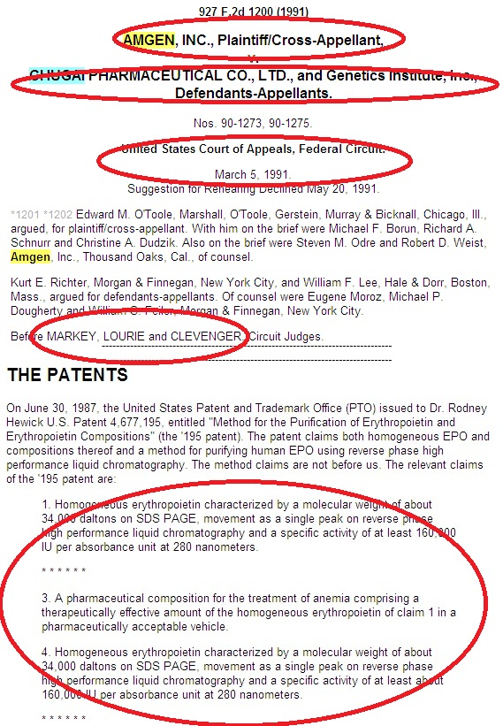
Challenges – Court Case Documents
Court Cases are not very well structured!
More difficult to parse information
PACER – an electronic system to access databases for U.S. Courts - requires one to know party/assignee name, case number/type, etc. which may not be known
Documents are available as image files
Notes:
Challenges with respect to court cases

Slide 10
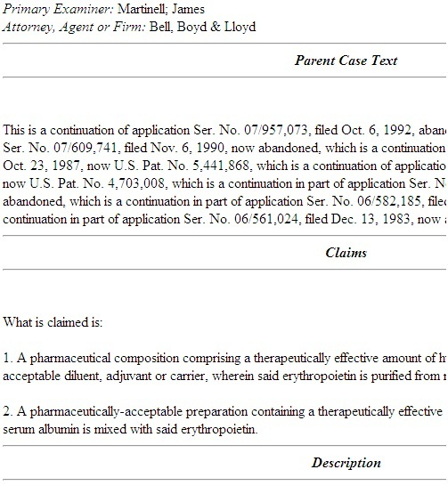
Challenges – Patents
Documents are available in HTML Format and easier to parse
Although – Currently over 7 million U.S. patents
In 2009 alone, 485,312 patent applications were filed
Information is contained in various sections of the documents; a full-text search alone is not sufficient – other fields such as classification, citations etc. need to be considered

Slide 11
Challenges – Summary
Documents vary from semi-structured to completely unstructured
Documents such as file-wrappers and court cases are available as image files
Corpus includes a large amount of information that cannot be manually parsed (PubMed contains around 20 million citations)
Additionally, the diversity is not only with information, but also with user expectations – How can a system cater to the subtle differences in user’s expectations for almost similar queries?
Notes:
In general, what are the challenges faced?

Slide 12
Cross-Referencing
Can we take further advantage of the information sources? -- YES!
COURT CASE
314 F.3d 1313 (2003)
AMGEN INC., Plaintiff-Cross Appellant v. HOECHST MARION ROUSSEL, INC. (now known as Aventis Pharmaceuticals, Inc.) and Transkaryotic Therapies, Inc., Defendants-Appellants.
…
Plaintiff-Cross Appellant Amgen Inc. is the owner of numerous patents directed to the production of erythropoietin ("EPO"), …alleging that TKT's Investigational New Drug Application ("INDA") infringed United States Patent Nos. 5,547,933; 5,618,698; and 5,621,080. The complaint was amended in October 1999 to include United States Patent Nos. 5,756,349 and 5,955,422, which issued after suit was filed.
REGULATIONS:
U.S. Code Title 35, C. F. R Title 37, M. P. E. P. …
Publication Database
FILE WRAPPER
U.S. Patent 5,955,422
…
Claims 61-63 are rejected under 35 U.S.C. § 103 as being unpatentable over any one of Miyake et al., 1977 (R)
…
In accordance with the provisions of 37 C.F.R. §1.607, the present continuation is being filed for the purpose of
…
PATENT
United States Patent, 5,955,422
September 21, 1999
Production of erthropoietin
Abstract: Disclosed are novel polypeptides possessing part or all of the primary structural conformation and one or more of the biological properties of mammalian erythropoietin ("EPO") …
Inventors: Lin; Fu-Kuen (Thousand Oaks, CA)
Assignee: Kirin-Amgen, Inc. (Thousand Oaks, CA) Appl. No.: 08/100,197
Filed: August 2, 1993.
BIOPORTAL: DOMAIN KNOWLEDGE
Notes:
The information sources heavily cross-reference one another. These references are an intuitive way for humans to relate documents. How can we take advantage of the cross-referenced information?

Slide 13
Goals
Need to develop a standardized representation by defining classes and class hierarchies for the document domains
Need to define relationships between the classes which explicitly state the cross-referencing
Proposed Solution: Develop a Patent System Ontology

Slide 14
Patent System Ontology: Design
Identify important “metadata” and “zones” in the documents
Abstract the terms into classes and define relationships between them
Our primary goal is to facilitate Information Retrieval
The “knowledge” should be able to answer multi-domain queries
The choice of representation language should be widely accepted
Notes:
We first identify and enlist terms, metadata, zones (text areas) and referenced information in each information source. Following the Ontology-101 procedure, we define several competency questions that we expect the final system to be able to answer.
We look at all the domains with an Information Retrieval perspective.

Slide 15
Competancy Questions
Single Domain
Return all patent documents which contain the keyword “erythropoietin” in the “claims”
Return all court cases which involve “Amgen_Inc” either as the plaintiff, defendant of both, and from the court “courtA”
Multi-domain:
Return all patents which contain the keyword – “erythropoietin” in the “claims”, which have been challenged in the courts
The complexity of the queries depends on the user’s requirement
In general, the ontology should be able to answer:
Textual queries
Metadata queries, with numeric filters
Multi-source queries

Slide 16
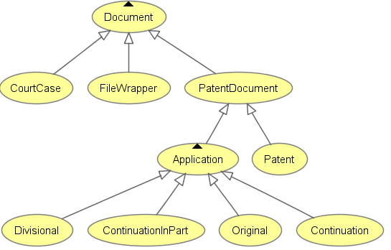
Class Hierarchy - I
Notes:
Explain the hierarchy

Slide 17
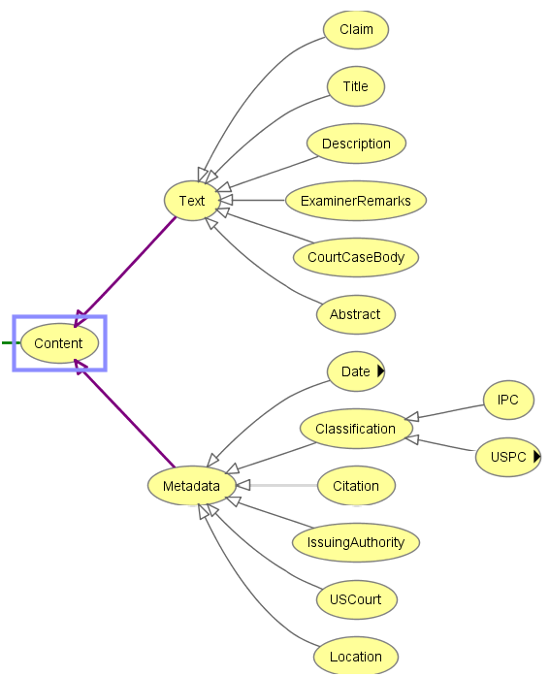
Class Hierarchy - II
Notes:
Split into three slides for the sake of readability

Slide 18
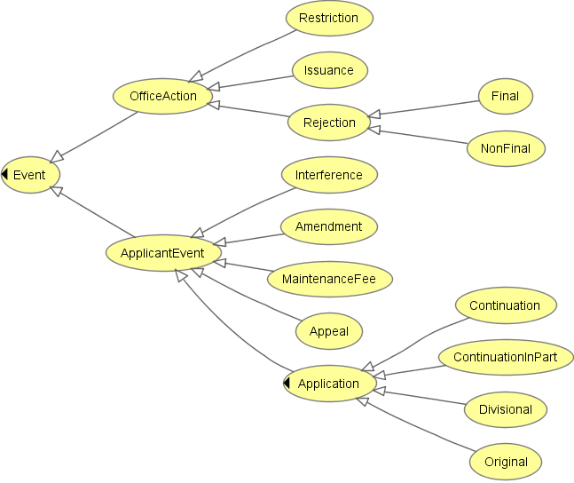
Class Hierarchy - III
Notes:
Relationships between the terms are not shown here. This is an additional implementation of the file-wrappers that was added later to the ontology.

Slide 19
Use Case
Core patents – U.S. Patents 5,621,080, 5,756,349, 5,955,422, 5,547,933, 5,618,698
135 directly related patents (through citations) form our gold standard for computing formal measures such as Precision and Recall
Identified over related 3000 publications through citations. These are available on PubMed and can be accessed through Entrez – A tool that provides a search interface to PubMed database
Total patent corpus of 1150 patents
Around 30 court cases, patent litigation involving major companies including Amgen, Hoechst Marion Roussel, Inc., Transkaryotic Therapies, Inc.
Comprehensive domain knowledge available - BioPortal
This corpus forms a good experimental platform to test the overall effectiveness of the framework
Notes:
Domain knowledge has been used to develop notions of semantics rather than just plain term matching. Mention BioPortal as a source for domain knowledge, and that domain knowledge will not be discussed in this paper.
Using BioPortal, we expanded “erythropoietin” to 43 related terms. Using these terms, we downloaded top 50-100 patents for each of the terms to gather a total of 1150 patents.

Slide 20
Instantiating the Ontology
Documents are automatically parsed using a regular expression based script
Separate scripts needed for each document domain
Ontology is automatically instantiated using the Protégé-OWL API
Chugai ..
hasDefendant
Amgen ..
Case 1
hasPlaintiff
Notes:
The ontology is populated with actual physical documents from the use case corpus. This is currently done using regular expression parsers which identify the fields marked in red, and instantiate the appropriate classes and properties from the ontology.
The accuracy of the extracted information is very important in order to make the data valuable. Currently, patent documents are fully automatically parsed, while court cases are more difficult to parse.

Slide 21
So Far …
54 Classes, 40 Properties and over 15,000 individuals from 1150 patents, 30 court cases and one partially instantiated file wrapper
Used Protégé-OWL to edit the ontology and Protégé-OWL API to programmatically instantiate physical documents
Can query any SPARQL endpoint such as Protégé or Virtuoso’s Triple Store
Can also use SWRL to query (We haven’t developed SWRL query rules)
Notes:
A summary of the state of the ontology (this is an updated version when compared to the values given in the paper)

Slide 22
Querying with SPARQL
SPARQL is a query language for RDF
Syntactically very similar to SQL – for relational databases
Any number of variables can be specified
Many triples can be used in conjunction to form more complex queries
We will use Virtuoso’s triple store to query the ontology
Operation
Variables
SELECT ?subject ?predicate ?object
WHERE {
?subject ?predicate ?object
}
Triples
Notes:
Explaining SPARQL’s structure. The following slides will have SPARQL queries in them.

Slide 23
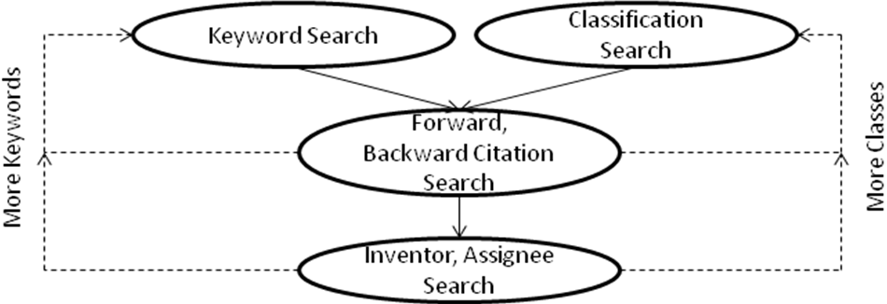
Scenario: Patent Prior Art Search
Prior art search is important for any organization looking to protect their innovation
Typical prior art search starts out broad and takes several iterations
Notes:
Explain patent prior art search as a common use case scenario, and walk through a few examples.

Slide 24
Court Cases with “Erythropoietin”
SELECT DISTINCT ?cases
WHERE {
?cases a :CourtCase .
?cases :hasBody ?caseBody .
?caseBody :resourceVal ?comment .
FILTER REGEX (?comment, "erythropoietin", "i") .
}
Case_4: Amgen v/s Chugai …
Case_5: Amgen v/s Genetics In.
Case_2: Amgen v/s Chugai …
Case_3: Amgen v/s F. Hoffma…
….
30 Cases retrieved
Notes:
Start by searching court cases. Can also search patent documents (user’s preference)

Slide 25
Patents Involved in the Court Cases
SELECT DISTINCT ?patents
WHERE {
?cases a :CourtCase .
?cases :hasBody ?caseBody .
?caseBody :resourceVal ?comment .
FILTER REGEX (?comment, "erythropoietin", "i") .
?cases :patentsInvolved ?patents .
}
5411868
5621080: Production of Erythropoietin
5547933: Production of Erythropoietin
5618698: Production of Erythropoietin
5756349: Production of Erythropoietin
5955422: Production of Erythropoietin
5441868
4703008
4677195
5322837
Core Patents are in bold

Slide 26
Common US Classes, Inventors and Assignee
?inv
Lin_Fu-Kuen
Hewick_Rodney_M
Seehra_Jasbir_S
SELECT DISTINCT ?inv ?class ?assignee
WHERE {
?cases a :CourtCase .
?cases :hasBody ?caseBody .
?caseBody :resourceVal ?comment .
FILTER REGEX (?comment, "erythropoietin", "i") .
?cases :patentsInvolved ?patents .
?patents :hasInventor ?inv .
?patents :hasUSClass ?class .
?patents :hasAssignee ?assignee .
}
?class
USPC 530/380
USPC 530/399
USPC 530/397
USPC 514/8
USPC 435/69_6
USPC 530/835
USPC 530/388_7
…
?assignee
Kirin-Amgen_Inc
Genetics_Institute_Inc
…
Notes:
We can branch out at this stage to search what other patents inventor “Lin-Fu-Kuen” has, or what other patents “Genetics Institute” owns…

Slide 27
Extracting Citations
SELECT DISTINCT ?forw ?backw
WHERE {
?cases a :CourtCase .
?cases :hasBody ?caseBody .
?caseBody :resourceVal ?comment .
FILTER REGEX (?comment, "erythropoietin", "i") .
?cases :patentsInvolved ?patents .
?patents :hasCitation ?forw
?backw :hasCitation ?patents .
}
Results
6541033
4710473
4358535
4558005
4465624
4757006
4399216
4558006
3865801
3033753
…
Notes:
Following citations is a natural way of propagating search. We can search the patents through forward and backward citations.

Slide 28
Generated Results
Gathered Results
Case_4: Amgen v/s Chugai …
Case_5: Amgen v/s Genetics In.
Case_2: Amgen v/s Chugai …
….
Around 30 court cases
Several patents including core patents and forward/backward citations
Can search patents by the inventors, assignees and/or US class identified
What’s more? Can go search court cases with new keywords or information gathered
5621080: Production of Erythropoietin
5547933: Production of Erythropoietin
5618698: Production of Erythropoietin
5756349: Production of Erythropoietin
5955422: Production of Erythropoietin
…
5441868
4703008
4677195
5322837
…
Patents with Inventor: Lin_Fu-Kuen
Patents owned by Genetics_Inc
…
Notes:
So far, we’ve collected several results, both patents and court cases. By following citations, US Class, Inventors etc. we identified more patents.
The search can proceed as long as required, until a satisfiable point is reached. One could proceed to search the court cases for involvement of any of the newly identified patents and so on..

Slide 29
Current Limitations
One needs to know SPARQL in order to query
One needs to know the semantics of the ontology such as the relations, domain and range restrictions etc.
Performing manual querying can be very time consuming. Automation is needed
Domain specific semantics need to be separately integrated
Probabilistic weighing – ranking inventors, assignees, patents etc. is not possible using the SPARQL endpoint
We are developing a user-friendly automated tool to search the patent system

Slide 30
Future Work
Include other information sources – publications, regulations, laws
Develop automated tool and search framework
Integrate domain knowledge into the tool
Experiment with more use cases outside of the biomedical domain

Slide 31
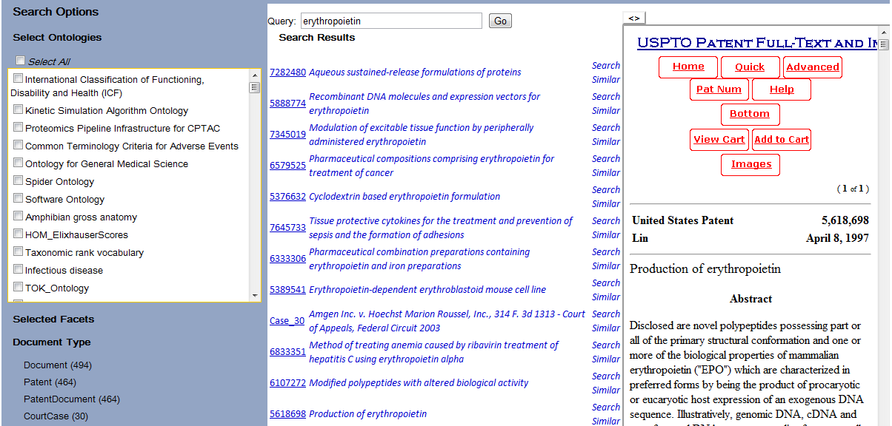
Tool Snapshot
Notes:
Explain the different features of the tool … and a brief overview of how it uses the ontologies

Slide 32
Acknowledgement
This research is partially supported by NSF Grant Number 0811975 awarded to the University of Illinois at Urbana-Champaign and NSF Grant Number 0811460 to Stanford University. Any opinions and findings are those of the authors, and do not necessarily reflect the views of the National Science Foundation.

Slide 33
Thank You!
Questions?

