Slide 1
REGNET
Information Management and Compliance Assistance for Patent Laws and Regulations
PIs: Jay Kesan, University of Illinois at Urbana-Champaign
Kincho Law, Gio Wiederhold, Stanford University
Senior Personnel: Gloria Lau
Students: Hang Yu, Siddharth Taduri
Notes:
1

Slide 2
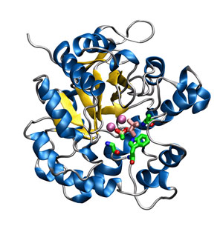
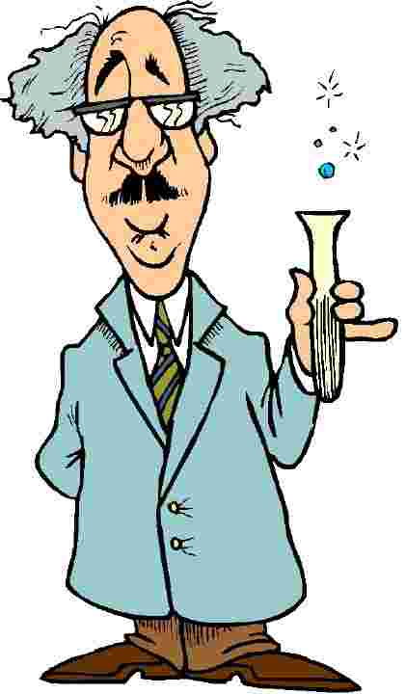
PROBLEM STATEMENT
How to develop a comprehensive knowledge of patents in a particular technological space?
This task involves extensive study of patent documents, scientific publications, and other govt. agency and court documents
Technology Firms’ Concerns
Can I get patent protection for my innovation?
Do I build or do I buy related technologies?
What are my competitors doing?
How strong are their patents?
Am I perhaps infringing on someone else’s patents?
Is so, are those patents valid?
Have they been enforced in court?
Has their validity been challenged in court?
2
Motivation

Slide 3
PROBLEM STATEMENT
Patent Validity and Enforcement Questions involves analysis of documents in various domains – World-wide Patents, PTO File Wrappers, Scientific Publications and Court documents
These domains are incompatible with each other and each needs a different approach
Goal: Provide a single framework, interface to collect a comprehensive set of related documents from each of these incompatible domains
PATENTS
PUBLICATIONS
PTO FILE WRAPPERS
COURT CASES
LAWS & REGULATIONS
3
Motivation

Slide 4
BACKGROUND
Many patent documents and research tools/resources available online (free and paid – Google Patent, espace, USPTO, WIPO, Delphion, MicroPatent, …)
Many resources available for scientific publications/journals (PubMed, MedLine, IEEE, Google Scholar, etc…)
Thomson Reuters/Innovation brings together the Derwent Patent index, Web of Science for publications and Inspec, a bibliographic tool
Dialog LLC is an online information retrieval system for Patents, Medical databases, News, and other technical Journals
Fewer resources available to access PTO file wrappers, court documents, and laws and regulations
4
Motivation

Slide 5
PATENTS
Over 7 million U.S. patents
In 2009, 485,312 patent applications were filed
Foreign Patents (DWPI, European, German, Japanese, etc..)
Patent Sources: USPTO, Delphion, WIPO, Derwent Patent Index, Google Patents …
Keyword based search results are imprecise and low in recall
5
Challenges

Slide 6
IP LITIGATION
Court cases are important - A patent that has been litigated is valuable
94 District Courts & one Court of Appeals (CAFC)
PACER – an electronic system to access databases for U.S. Courts
PACER requires one to know party/assignee name, case number/type, etc…
Other options – Google Scholar
Keyword based search may not be effective because of information overload and lack of context
6
Challenges

Slide 7
USPTO PROCEEDINGS: FILE WRAPPERS
Patent file wrappers contain information about scope of protection; application/patent data, prosecution history, application history, and other examination information
Available on PAIR (Patent Application Information Retrieval)
Public PAIR – Displays issued or published application status
Private PAIR – Real-time current patent application status
Some file wrappers are only available as images and text cannot be automatically extracted
7
Challenges

Slide 8
SCIENTIFIC PUBLICATIONS
Very broad set of topics need to be searched
Many databases must be searched
Current options include – PubMed, MedLine, Google Scholar, etc...
PubMed contains articles from over 300 research journals
Can we determine the state-of-the-art at the time of filing of a patent application?
8
Challenges

Slide 9
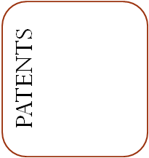
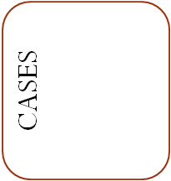
Proposed Framework
Step 1: Expand Keywords
User Query
Step 2: Independently search domains
Framework
Step 3: Combine Results + Rank
Step 4: Consider User Feedback
9
Proposed Framework

Slide 10
STEP 1: EXPAND KEY WORDS
Goal: Expand the user query using ontologies/taxonomies (BioPortal, GeneCards, MedTerms)
Simple Example:
Doc A
The car has a 3.5l V6 engine
Doc B
The vehicle has a 3.5l V6 engine
Keyword search for “car” will return only Doc A. An ontology that describes the term “vehicle” as a synonym, or a parent of “car” will internally expand the query to return both Doc A and Doc B
Challenges:
Picking the right ontology (An imprecise ontology may result in irrelevant keywords)
Combining various ontologies
10
Proposed Framework

Slide 11
STEP 2: INDEPENDENTLY SEARCH DATABASES
Goal: Find relevant documents in a database of homogenous documents (e.g., Patents, or publications)
Challenges:
Patents: Appropriate weighing of various features such as patent assignee, inventor, forward and backward citations, …
Cases: How can we obtain data in a search format? PACER does not provide a keyword based interface
File Wrappers: Automatic text extraction can be hard as some documents are scanned as images.
Adapting search to user preference of Type-I and Type-II errors
11
Proposed Framework

Slide 12
STEP 3: Combine results from the four different domains
Goal: (1) Cross-reference results from other domains
(2) Rank results
Challenges:
Establishing links between various domains
Improving the quality of search in one domain using results from another
Feature Extraction
Ranking documents requires combining many features with an appropriate weighting function
12
Proposed Framework

Slide 13
STEP 4: CONSIDER User Feedback
Goal: Consider user feedback from domain experts
Challenges:
What format or scale should the feedback be taken in? (yes/no, paragraph)
How must these be integrated with the system?
How can we resolve conflicting thoughts?
13
Proposed Framework

Slide 14
EXPERIMENTATION/METHODOLOGY
Build a Use Case to implement the functional requirements
It will provide a basis for experimentation
Chosen Use Case: “EPO/Erythropoietin”
Erythropoietin is a hormone that regulates the production of red blood cells
Synthetic production of this hormone holds significance in treatment of many diseases such as Anemia
14
Use Case: EPO

Slide 15
USE CASE: EPO/ERYTHROPOIETIN
Why does this make a good use case?
Core patents – U.S. Patents 5,621,080, 5,756,349, 5,955,422, 5,547,933, 5,618,698
135 directly related patents and over 3000 related publications
Around 20 court cases, patent litigation involving major companies including Amgen, Hoechst Marion Roussel, Inc., Transkaryotic Therapies, Inc.
Several available ontologies: Gene ontology, National Cancer Institute Thesaurus …
This corpus forms a good experimental platform to test the overall effectiveness of the framework
15
Use Case: EPO

Slide 16
PATENTS
Search results for “erythropoietin” amongst the 135 closely related patents:
Documents are indexed from search using Apache Lucene
Rank computation is based on the general idea that a term occurring more frequently across many documents (e.g., “the”) is less informative than a term (e.g., “EPO”) that occurs frequently in fewer documents
Returns over 7000 documents from over 7 million documents in the USPTO database
Returns ~90 of the 135 related patents
Patent Number | Rank
5955422 | 0.109
6204247 | 0.000
6245740 | 0.018
6270989 | 0.000
6280977 | 0.027
6340742 | 0.113
6420339 | 0.000
6420340 | 0.000
6524818 | 0.009
U.S. Patent No. 6,204,247 is relevant but does not contain the term erythropoietin
Q: How can this be made better?
16
Use Case: EPO

Slide 17
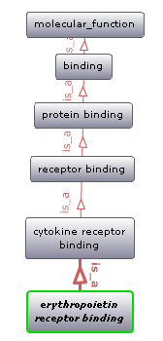
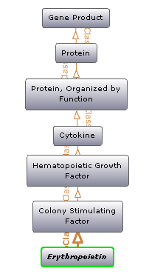
ONTOLOGY
BioPortal: Web-based application for accessing and sharing biomedical ontologies developed at National Center for Biomedical Ontologies (NCBO)
Gene Ontology (GO): GO uses three organizing principles – Cellular component, Biological process and Molecular function. This ontology represents “erythropoietin receptor binding” as a molecular function.
National Cancer Institute (NCI) Thesaurus: Provides reference terminology, vocabulary for clinical care, translational and basic research, and public information and administrative activities
Expanded Term Base
“Erythropoietin”, “Erythropoietin Receptor Binding”, “Colony Stimulating Factor”, “Cytokine” …
a
b
(a) Gene Ontology
(b) NCI Thesaurus
17
Use Case: EPO

Slide 18
RESULTS AFTER USING EXPANDED TERM BASE
Improved results: more relevant documents are identified
The 5 core patents have a relatively high rank
Returns a large set of documents when searched in USPTO (185,126 documents contain “protein”; 23,759 contain “cytokine”…)
Computed rank is the average of document ranks for each individual keyword
Patent Number | Rank
5955422 | 0.050
6204247 | 0.028
6245740 | 0.038
6270989 | 0.005
6280977 | 0.008
6340742 | 0.049
6420339 | 0.026
6420340 | 0.028
6524818 | 0.015
18
Use Case: EPO

Slide 19
ADDITIONAL FEATURES
Metadata: assignee, inventor, location, date, classification…
Q: How is this data useful?
File wrappers can be easily retrieved
Keywords for publications can be extracted from the references cited by the Patent
Cases clearly cite patents under litigation, inventor/assignee names, etc...
19
Use Case: EPO

Slide 20
Other Issues and Challenges
USPTO disallows crawling. An alternative automatic downloading is to be found
PAIR enforces CAPTCHA verification, hindering automatic downloading
No single database for all medical journals
Final index size could be very large
Academic publications/citations: How do we efficiently search for them? Entrez (National Center for Biotechnology Information) covers a large set of them, but it is still to be explored
PACER is a good source for litigation documents, but all court pleadings are scanned as electronic images, are they machine readable?
Since PACER does not provide keyword based search, difficult to manually scan 94 judicial districts
20
Other issues and challenges

Slide 21
CURRENT STATUS & FUTURE WORK
Current Status
Expanded keywords from available ontologies on BioPortal
Downloaded and indexed Patents, Cases and Publications directly related to the use case
Experimented on Patents
Future Work
Finalize use case – extract features, cross reference documents in different domains
Implement the proposed framework
Provide a web interface and relevance feedback technique
21
Current Status and Future Work

Slide 22
USEFUL LINKS
Patents
USPTO – http://www.uspto.gov/
Delphion – http://www.delphion.com/
Google Patents – http://www.google.com/patents/
File Wrappers
PAIR – http://portal.uspto.gov/external/portal/pair/
Court Cases
PACER – http://pacer.psc.uscourts.gov/
Publications
Pubmed – http://www.ncbi.nlm.nih.gov/pubmed/
Medline – http://www.nlm.nih.gov/medlineplus/
Google Scholar – http://scholar.google.com/
Ontology/Taxonomy
BioPortal – http://bioportal.bioontology.com/
Genecards – http://www.genecards.org/
MedTerms – http://www.medterms.com/
Miscellaneous
Thomson Innovation – http://www.thomsoninnovation.com/
Dialog – http://www.dialog.com/
22

Slide 23
ACKNOWLEDGEMENT
This research is partially supported by NSF Grant Number 0811975 awarded to the University of Illinois and NSF Grant Number 0811460 to Stanford University.
Any opinions and findings are those of the authors, and do not necessarily reflect the views of the National Science Foundation.
23

Slide 24
DISCUSSION
24

